Slide 1
8 C
A NIGHT IN A HAUNTED HOTEL

Slide 2
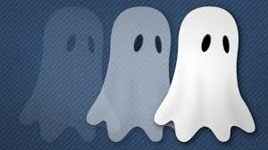
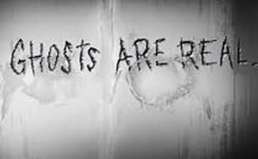
DO YOU BELIEVE IN GHOSTS?
DO YOU KNOW PEOPLE WHO BELIEVE IN GHOSTS?

Slide 3
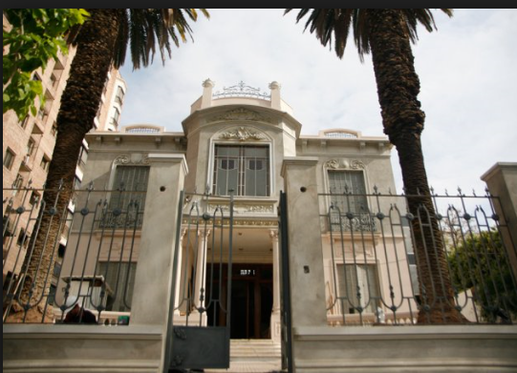
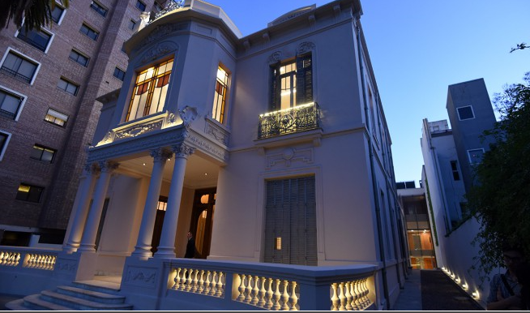
Are there haunted buildings in your town or city?
If a place is haunted, people think that there are ghosts there.
Some people believe that the Stoppel mansion (in Emilio Civit Street is haunted)
The Stoppel mansion
Carlos Alonso Museum

Slide 4
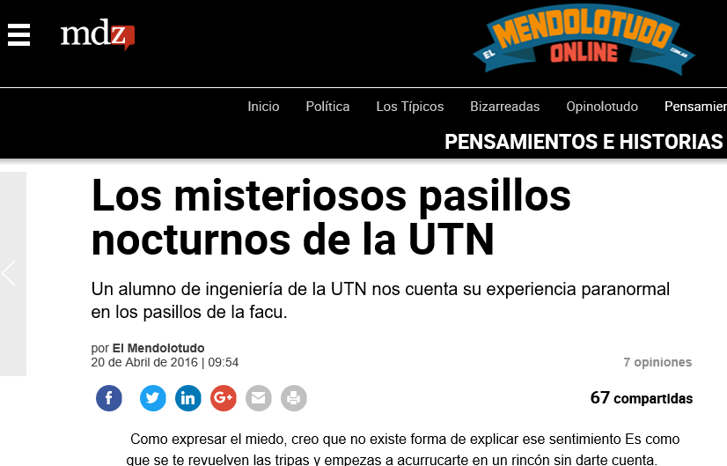
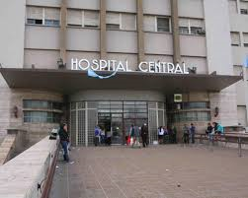
Some people believe that our university is haunted!
Some others believe that Central Hospital is haunted too!
There are many stories about haunted buildings in Mendoza.

Slide 5
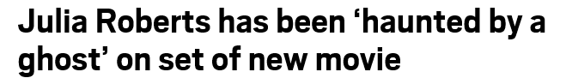
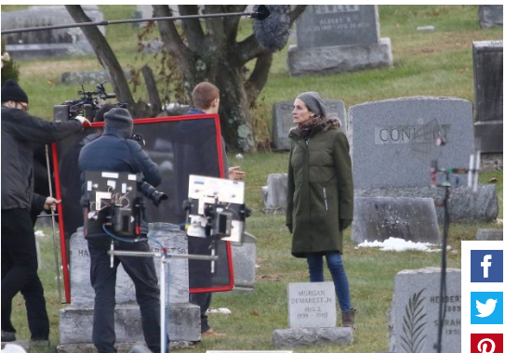

Slide 6
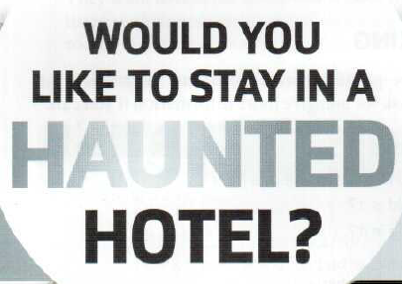
Yes, I would!
No, I wouldn’t!

Slide 7
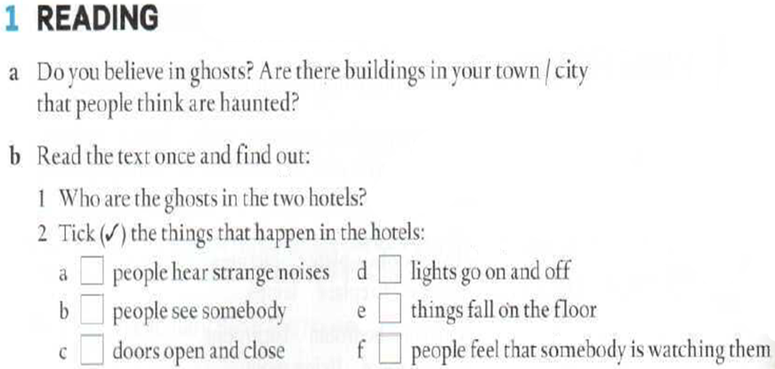


Slide 8
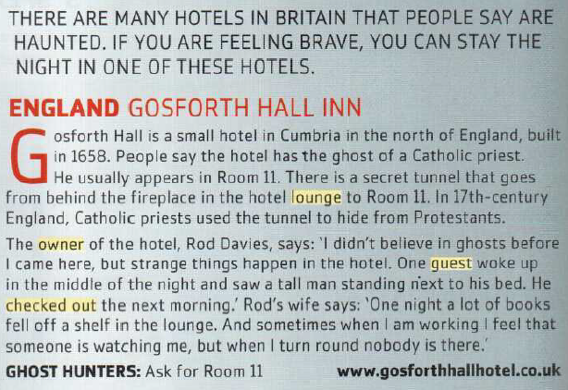

Slide 9
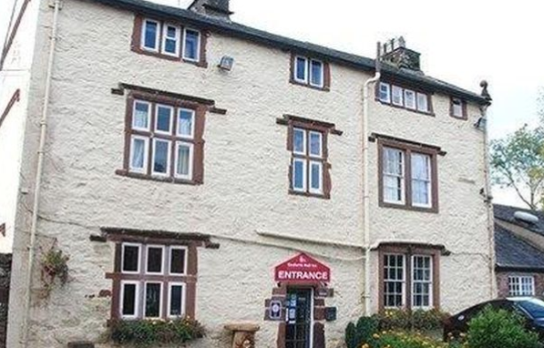
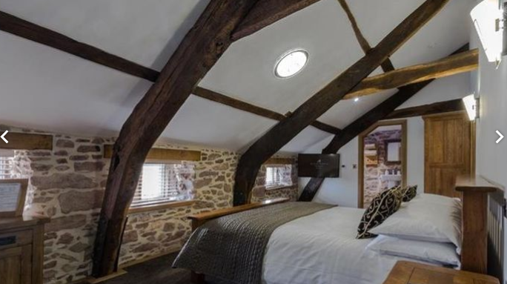
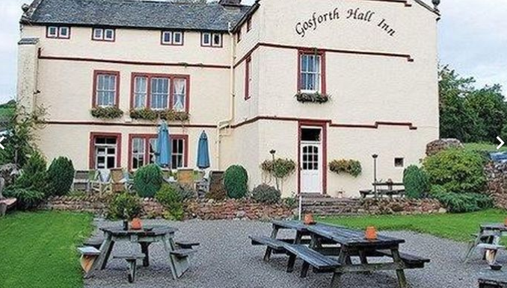
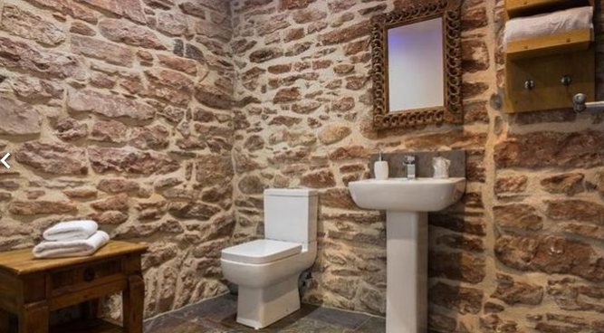
Gosforth Hall Inn
An inn is a house providing accommodation, food, and drink, especially for travellers.

Slide 10
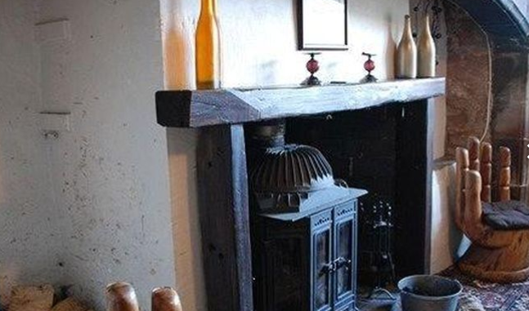
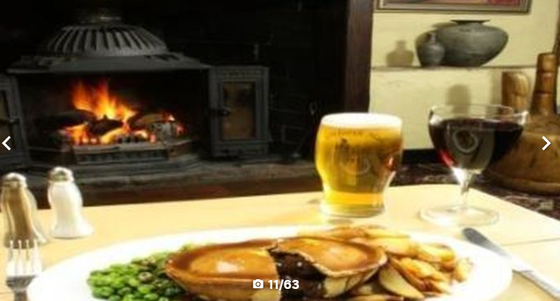
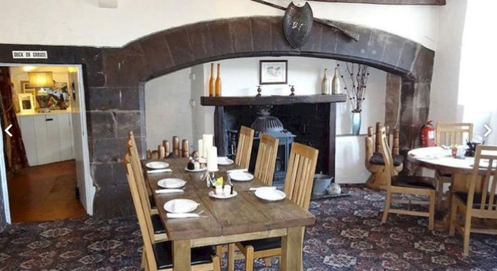
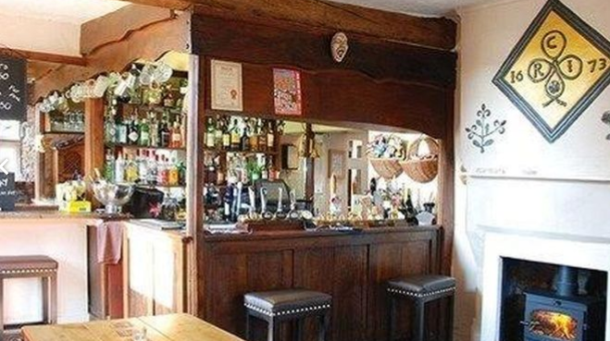
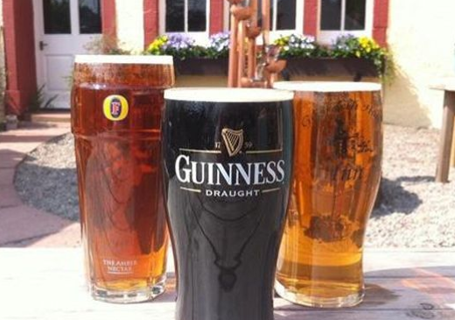

Slide 11
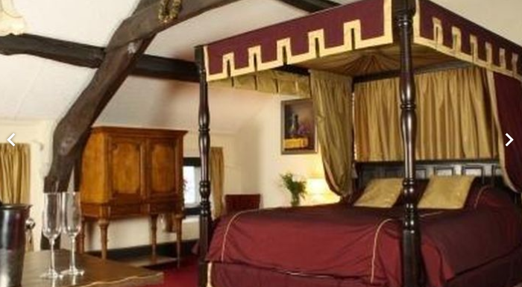
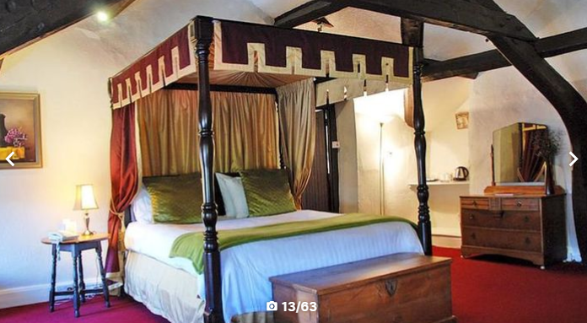
Room 11

Slide 12
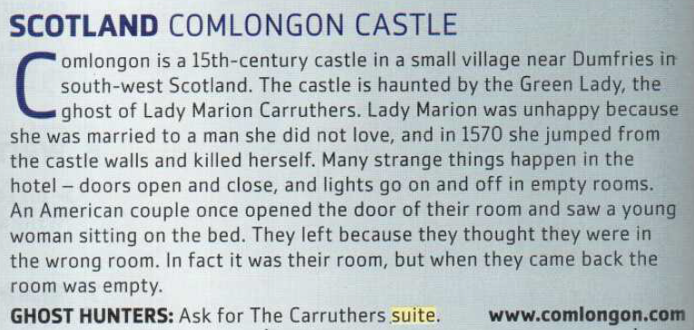

Slide 13
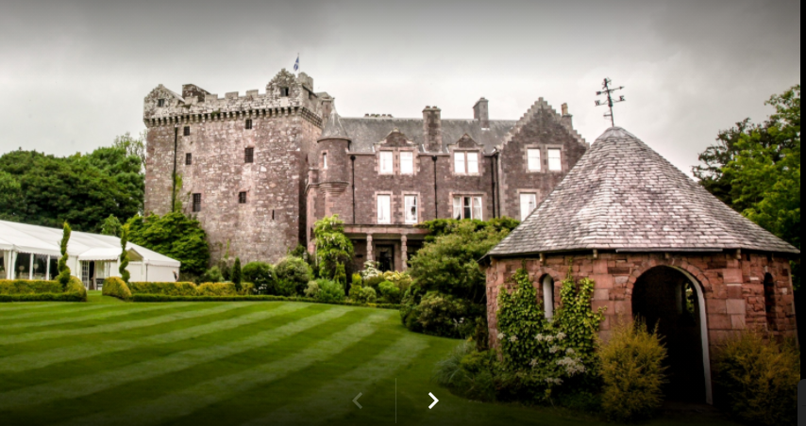
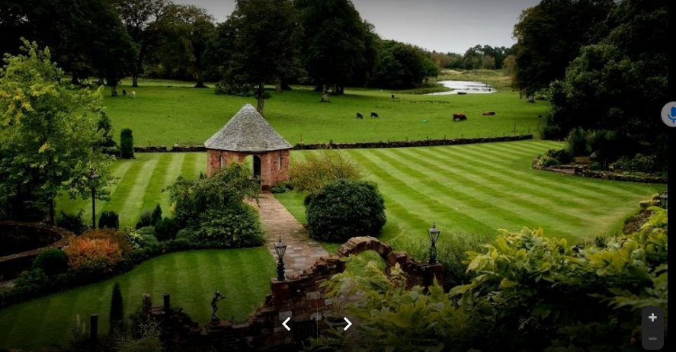
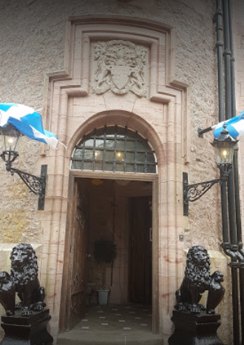
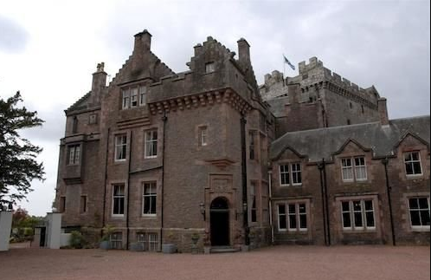
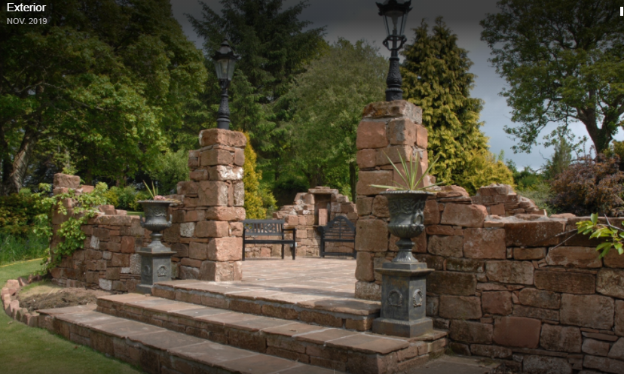
COMLONGON CASTLE

Slide 14
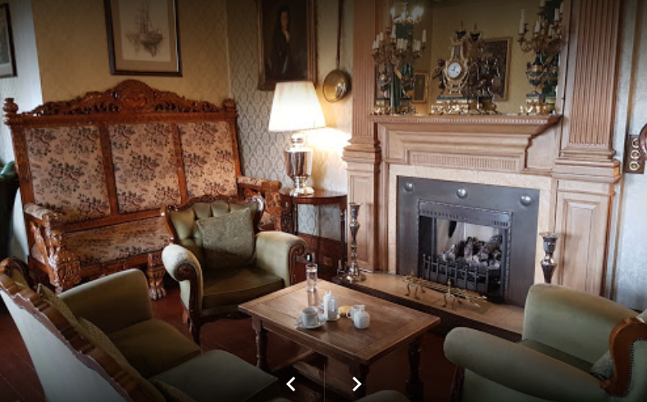
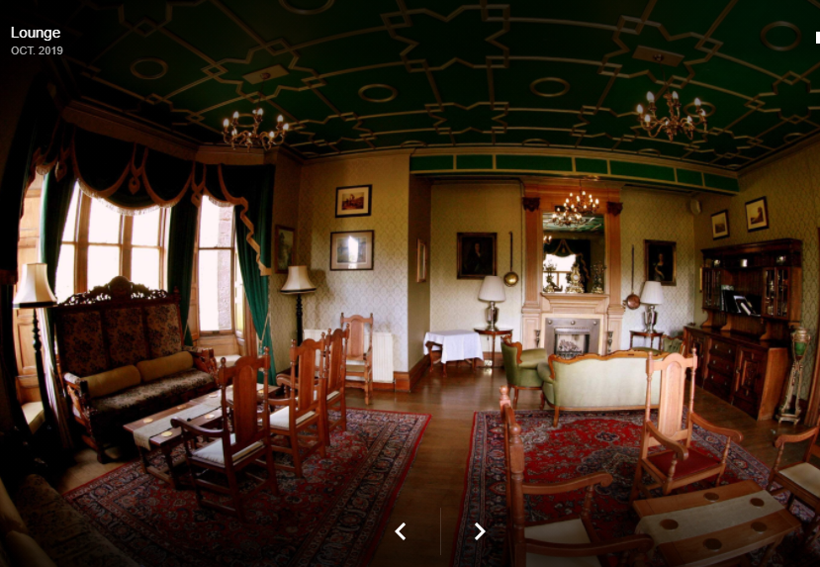
The lounge

Slide 15
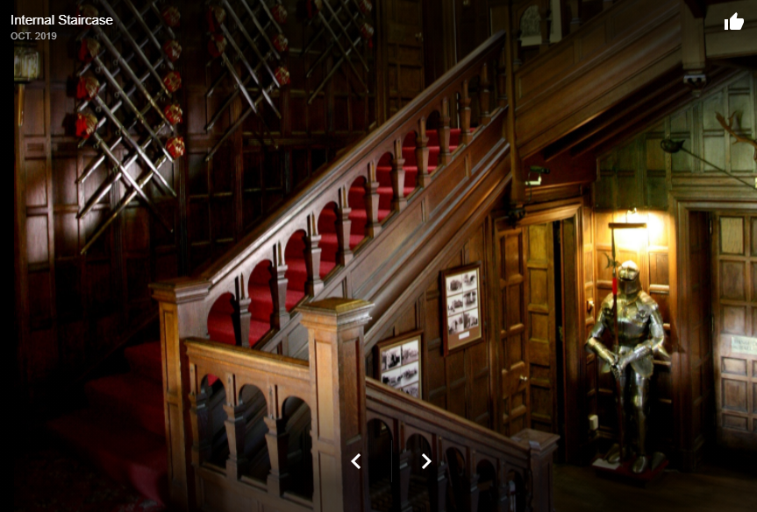
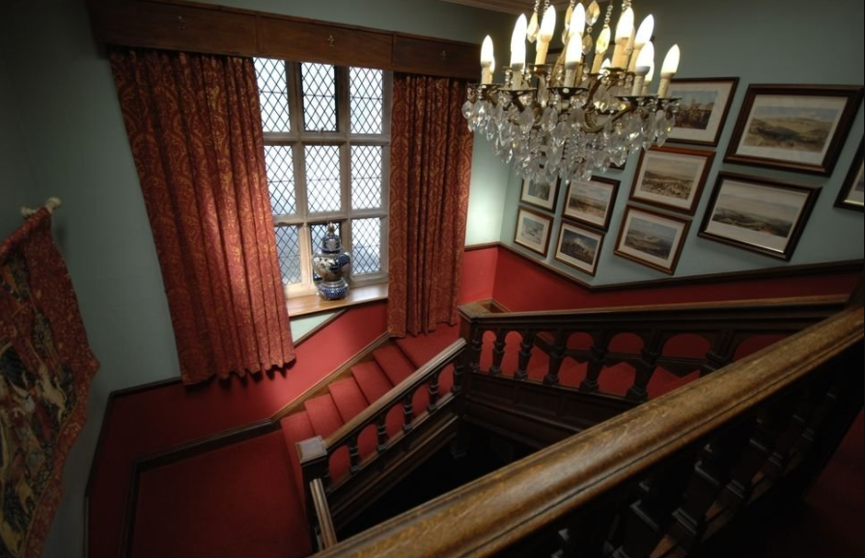
The stairs

Slide 16
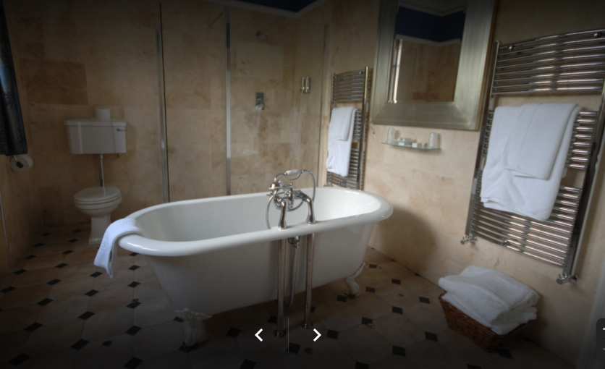

Slide 17
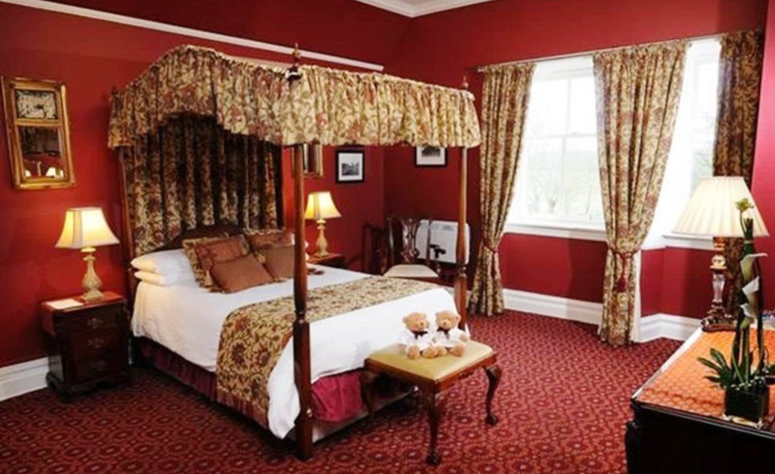
The Carruthers suite

Slide 18
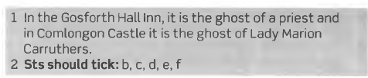
1 Who are the ghosts in the two hotels? 2 What strange things happen in these hotels?
https://view.genial.ly/6307a6188840dc00113c0772/presentation-copia-copia-8c-a-night-in-a-haunted-hotel

Slide 19
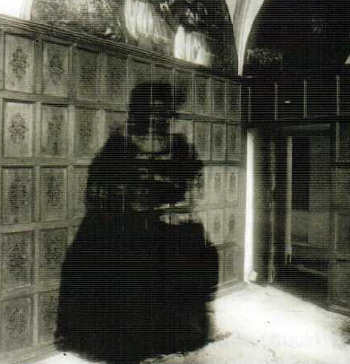

Slide 20
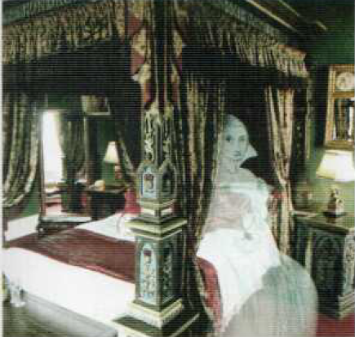
Where is the ghost of the woman sitting?
Who is this ghost? (according to the previous reading)

Slide 21
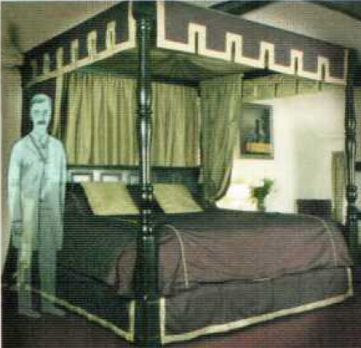
Where is the ghost of the man standing?
Who is this ghost?
(According to the reading)

Slide 22
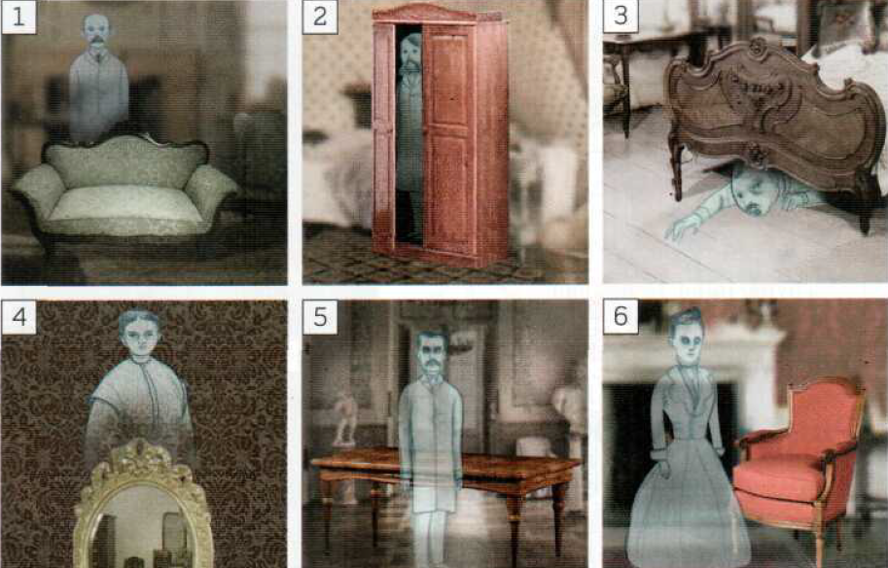
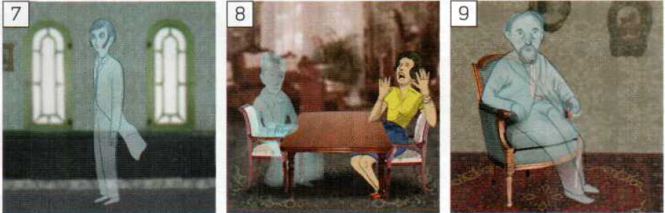
behind
Page 161
WHERE
IS
THE
GHOST
?
PREPOSITIONS
OF
PLACE
in
under
over
In front of
Next to
opposite
on
between
Listen to 4.21

Slide 23
Where is the ghost?
The ghost is behind the sofa.
The ghost is in the cupboard.
The ghost is under the bed.
The ghost is over the mirror.
The ghost is in front of the table.
The ghost is next to the armchair.
The ghost is between the windows.
The ghost is opposite the woman.
The ghost is on the chair.

Slide 24
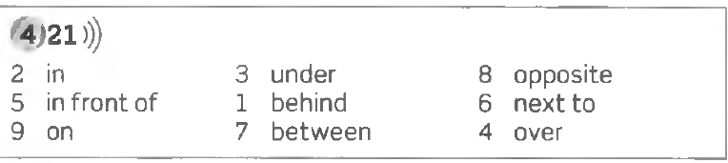
Prepositions of place

Slide 25
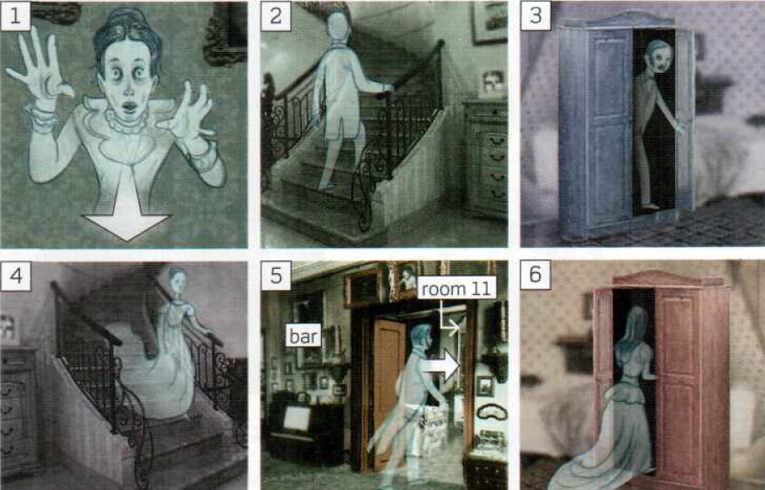
WHERE IS THE GHOST GOING ?
PREPOSITIONS
OF
MOVEMENT
towards
up
Out of
down
From…to
into

Slide 26
Where is the ghost going? (Answer using prepositions of movement)
1. The ghost is going towards me!
2. The ghost is going up the stairs.
3. The ghost is going out of the cupboard.
4. The ghost is going down the stairs.
5. The ghost is going from the bar to room 11.
6. The ghost is going into the cupboard.
Listen to 4.22

Slide 27
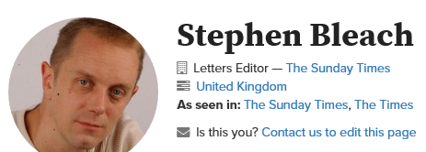
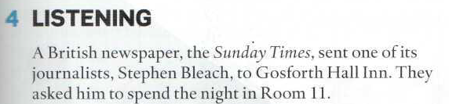
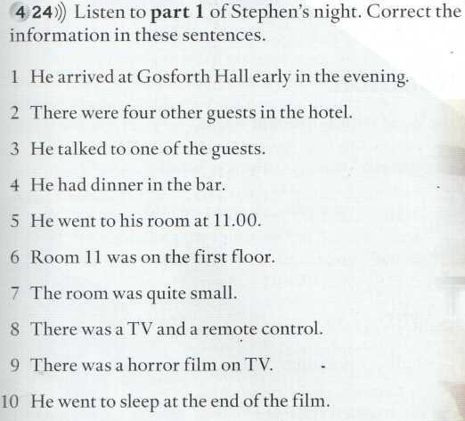
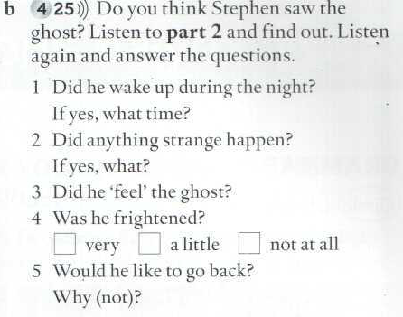

Slide 28
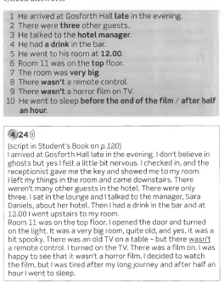
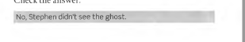

Slide 29
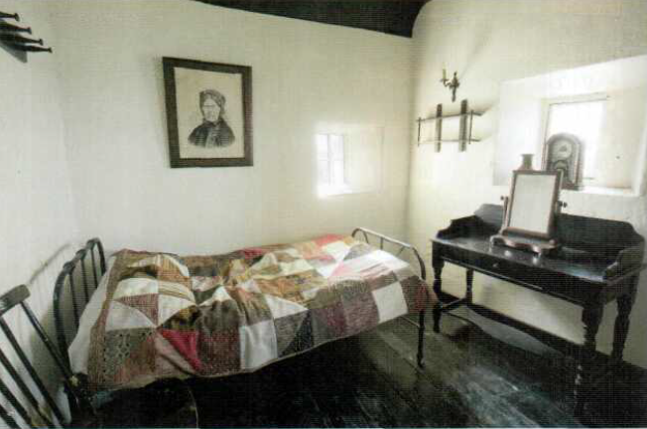
THERE WAS / THERE WERE (pages 104/109)

Slide 30
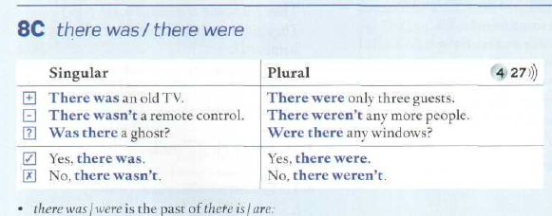

Slide 31

There were
There
was
there were
Was there
there wasn’t
there was
Was there
there was
there weren’t
were there

Slide 32

COMPLAINTS!
Page 139 memorize and say
there was a
there wasn’t a
there were some
there weren’t any
there weren’t any
there was a
there wasn’t a
there wasn’t a

Slide 33

Key to exercises page 139

Slide 34


were
wasn’t
was
were
was
was
weren’t
were

Slide 35

there wasn’t
there weren’t
Was there
there wasn’t
there wasn’t
was there
there weren’t
Were there
there were

Slide 36



Slide 37

next to
opposite
behind
under
from
in front of
from
to
over
up

Slide 38


Keys

Slide 39


4.28
v
Go to iTutor and watch the video.

Slide 40

Oxford Student’s site
https://elt.oup.com/student/englishfile/elementary3/grammar/file08/?cc=ar&selLanguage=en

